Slide 1


Slide 2
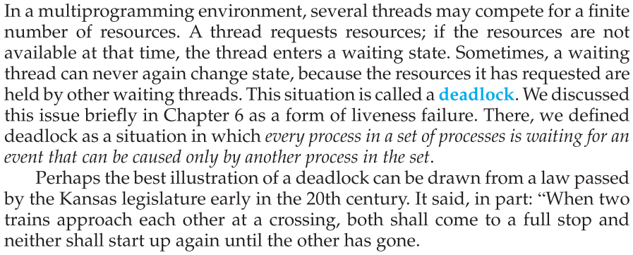

Slide 3
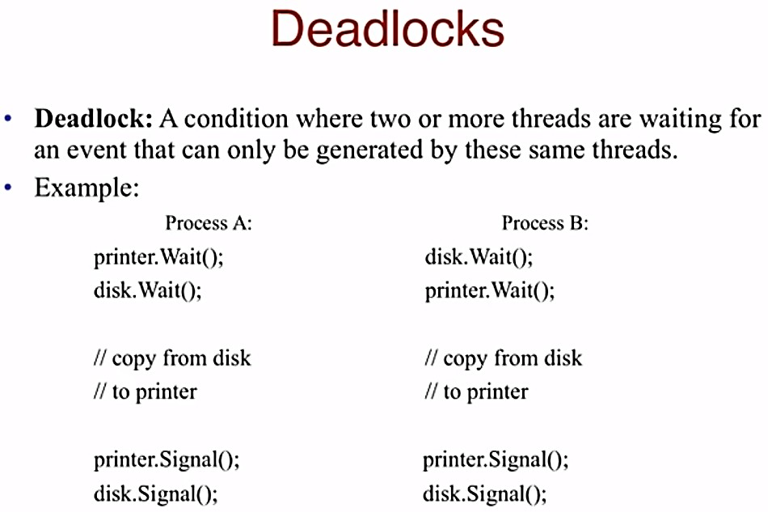

Slide 4
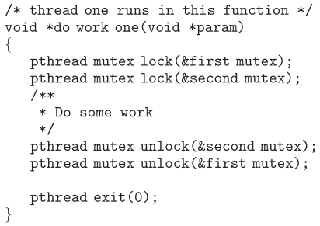

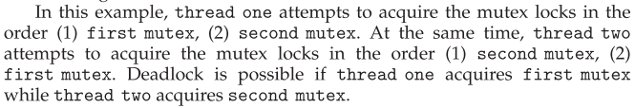
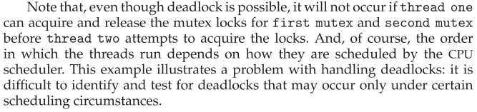

Slide 5
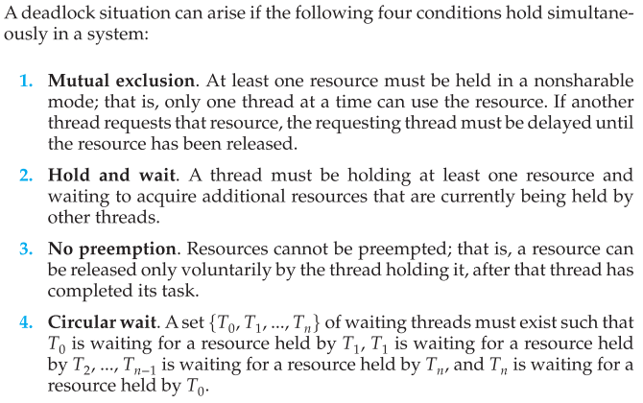

Slide 6
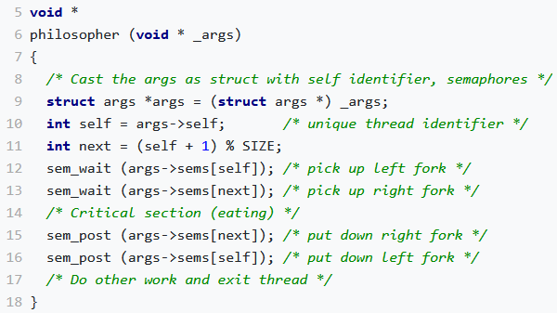
Consider the "dining philosophers" problem: n philosophers are sitting around a table, wanting to eat. Between each pair of philosophers is a single chopstick; a philosopher needs two chopsticks to eat. One possible way to write the pseudocode for each philosopher:
Assuming they are initialized to 1 and the standard sem_wait() is used, semaphores exhibit the three required system features of deadlock.
They enforce mutual exclusion because the second thread to attempt to down the semaphore will become blocked since the internal value would be negative.
Since the threads can acquire one and get blocked trying to acquire the second semaphore, they satisfy the hold-and-wait criterion.
And since no thread can break another thread’s claim to a semaphore, the no preemption criterion is met.
The fourth criterion for deadlock, circular wait, arises from the sequence in which the threads wait on the respective semaphores. Every philosopher is waiting on the fork to their right, which has been grabbed by someone else as their left fork.

Slide 7
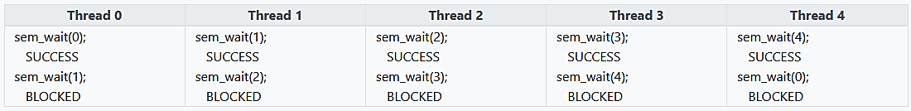
Illustrates how the circular wait arises. Every thread successfully waits on one semaphore and gets blocked by the second.

Slide 8
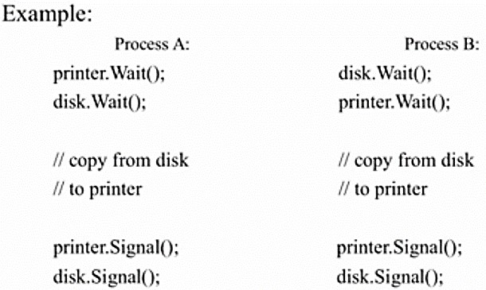


Slide 9
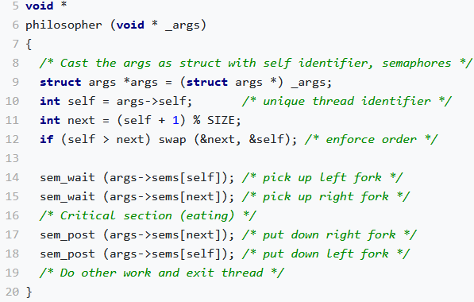
A third possibility for solving the dining philosophers problem is to impose a linear ordering on the semaphores. This order could be imposed by requiring i < j anytime sems[i] is accessed before sems[j]. As before, thread 0 would wait on semaphores 0 and 1 (in that order), thread 1 would wait on semaphores 1 and 2, and so on. However, the last thread would have a different ordering. If there are N semaphores (numbered 0 through N-1), the last thread would have to wait on semaphore 0 before semaphore N-1 to adhere to the linear ordering.

Slide 10
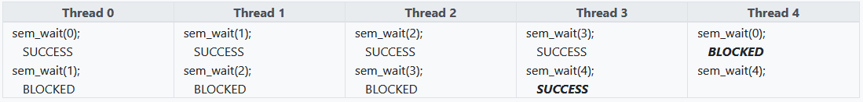
Since thread 4 must adhere to the linear order, it must try to wait on semaphore 0 before it can wait on semaphore 4. Assuming thread 0 arrived earlier and decremented semaphore 0 successfully as shown, thread 4 becomes blocked from the start. Consequently, thread 3 is successful in decrementing semaphore 4. The linear ordering prevents the circular wait that would cause deadlock.

Slide 11
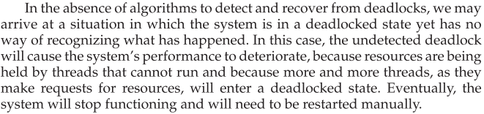

Slide 12
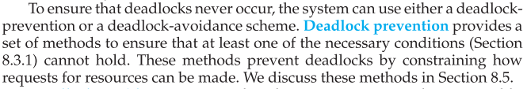

Slide 13
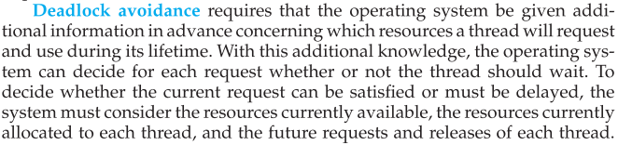

Slide 14
